Slide 1
Developing Data Products Course Project
Sai Preteek Medi
June 2015

Slide 2
Custom UK Football Statistics Explorer: By division.
This app allows the user to explore the dataset compiled by James Curley that has the results and goals for every league game of professional football in England since the 1880s: https://github.com/jalapic/engsoccerdata.

Slide 3
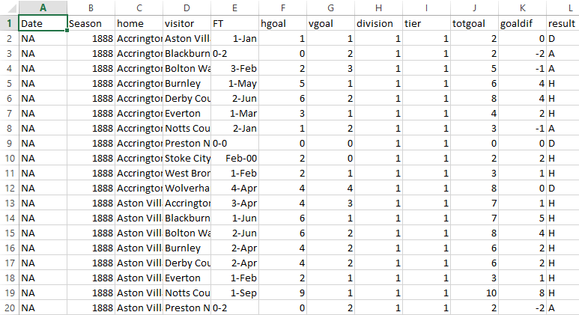
How It Works:
Original Data by James Curley is read into R
setwd("C:/Users/Student/Desktop/RWorkingDir/shiny/FootballPrediction")
theData <- read.csv("raw_data.csv", header = TRUE, sep = ",")
Produce Shiny page with widgets to allow exploration of the data:
sidebarPanel(
selectInput("tier", "Division:", choices=c(1,2,3,4)),
selectInput("themetric", "Metric:", choices=c('Total_Goals', 'Goals_Per_Game', 'Home_Team_Goals', 'Home_Team_GPG', 'Away_Team_Goals', 'Away_Team_GPG', "Home_Goal_Difference")),
sliderInput("season", "Season Range", 1888, 2013, value = c(1970, 2013)),
hr(),

Slide 4
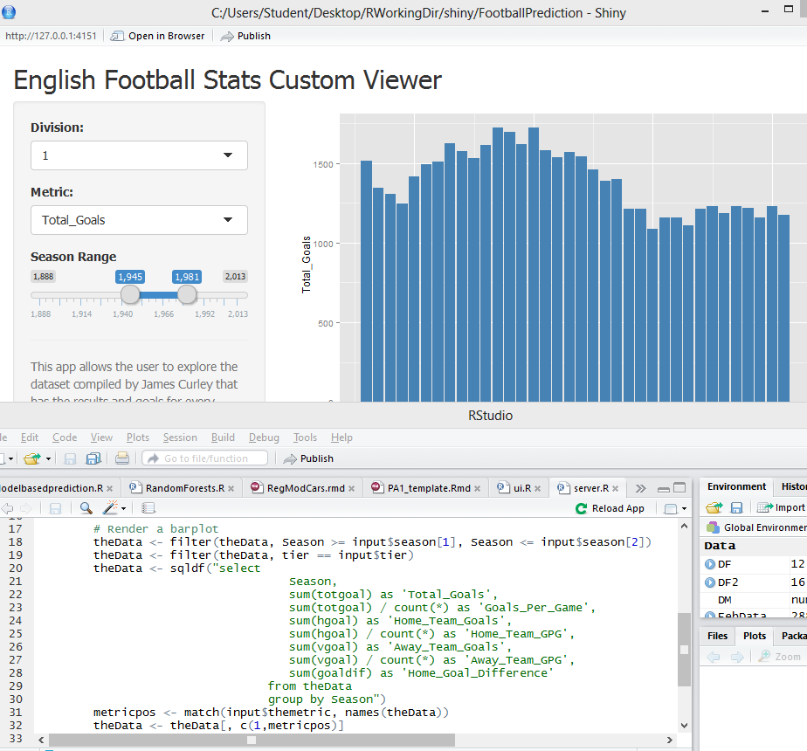
Use server.R to costumize input/output from ui.R
Take input from ui.R in the form of Division, season, and type of metric (total goals, goals per game etc).
Use server.R to filter/subset the raw data:
theData <- filter(theData, Season >= input$season[1], Season <= input$season[2])
theData <- filter(theData, tier == input$tier)
theData <- sqldf("select
Season,
sum(totgoal) as 'Total_Goals',
sum(totgoal) / count(*) as 'Goals_Per_Game',
sum(hgoal) as 'Home_Team_Goals',
sum(hgoal) / count(*) as 'Home_Team_GPG',…….

Slide 5
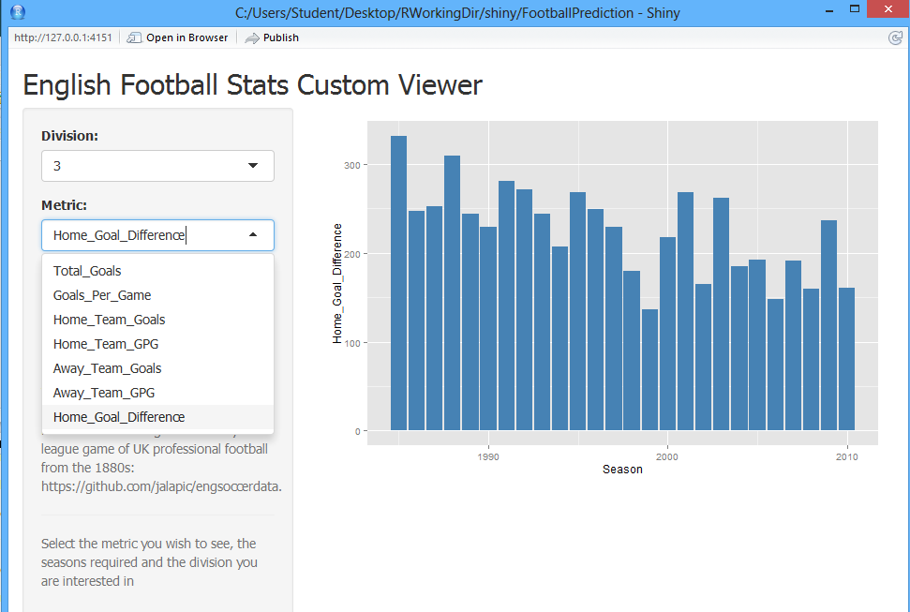
Use ggplot to plot the subsets chosen by App user in ui.R
metricpos <- match(input$themetric, names(theData))
theData <- theData[, c(1,metricpos)]
names(theData) <- c("Season", "Metric")
ggplot(aes(x=Season, y = Metric), data = theData) + geom_bar(stat = "identity", fill = "steel blue") + ylab(input$themetric)

